Slide 1
The Leading Asterisk

Slide 2
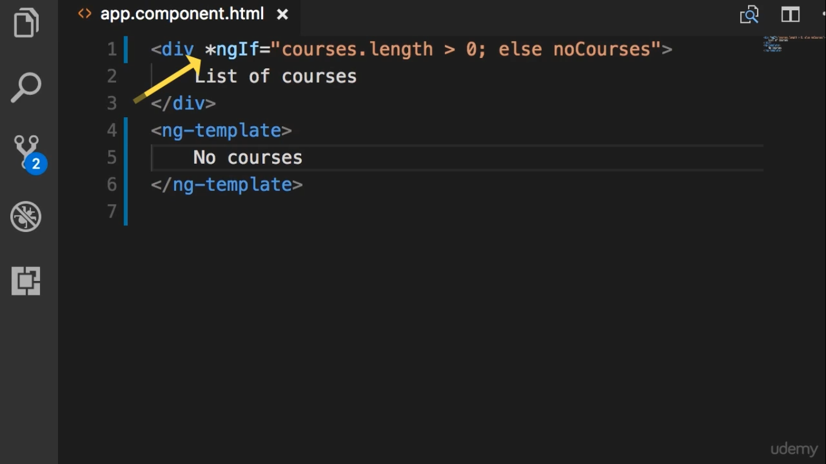

Slide 3
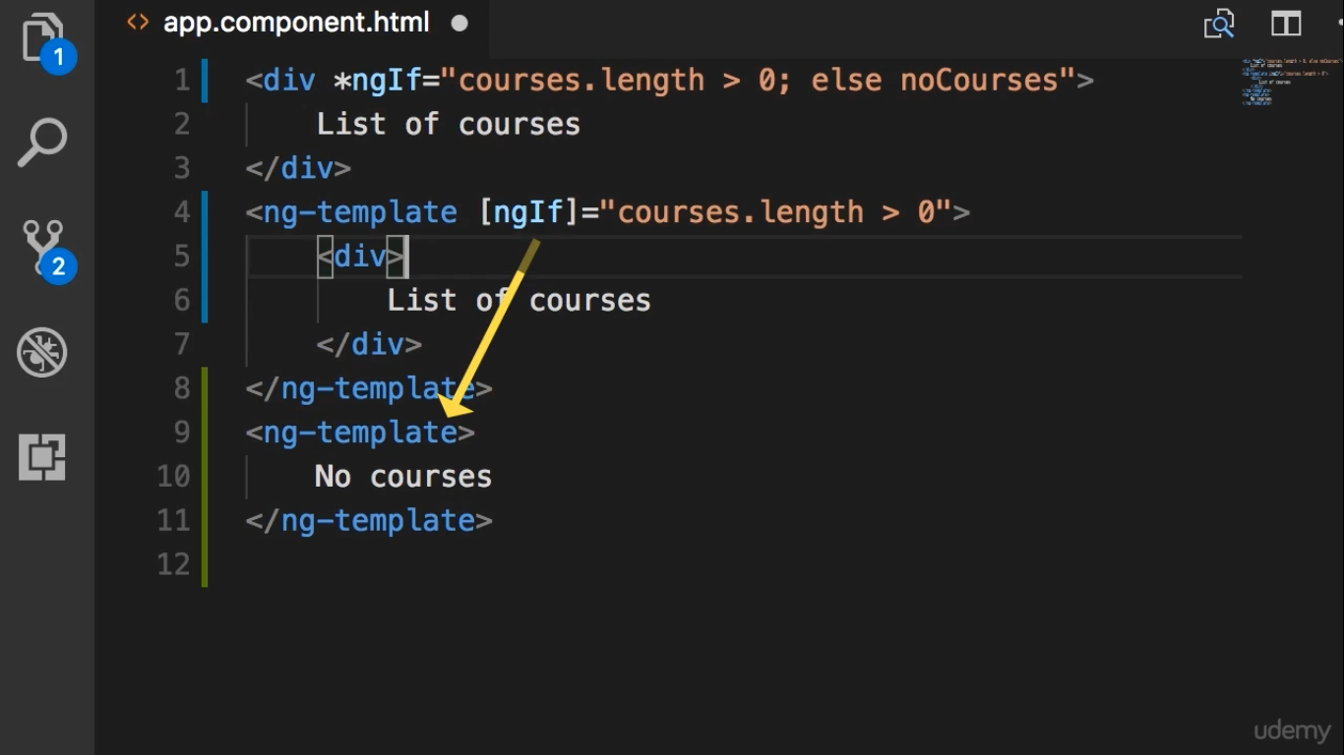

Slide 4
